Slide 1
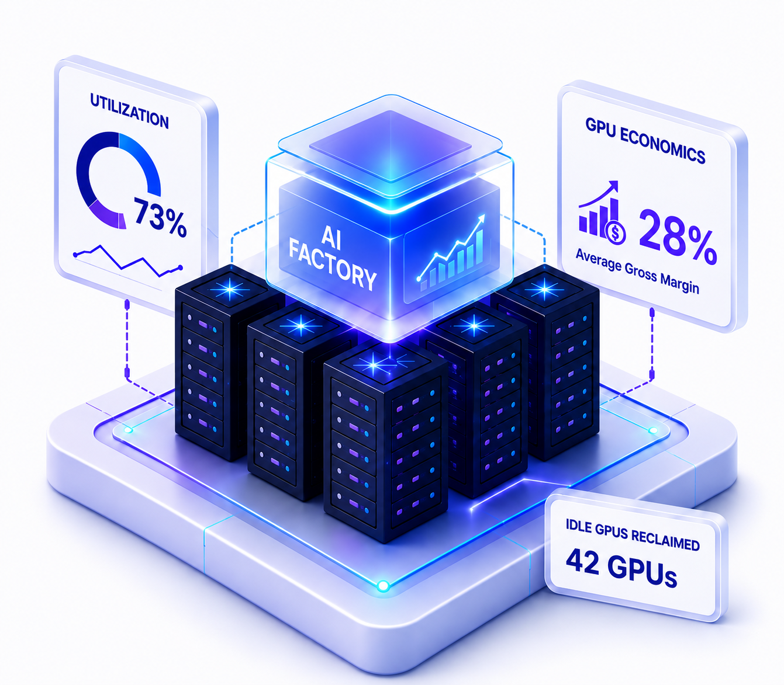
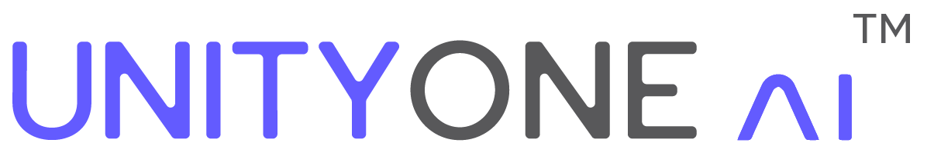
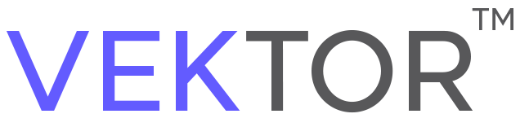






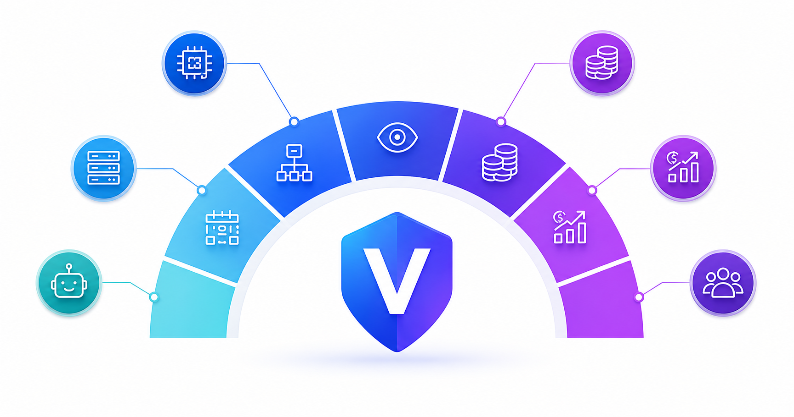






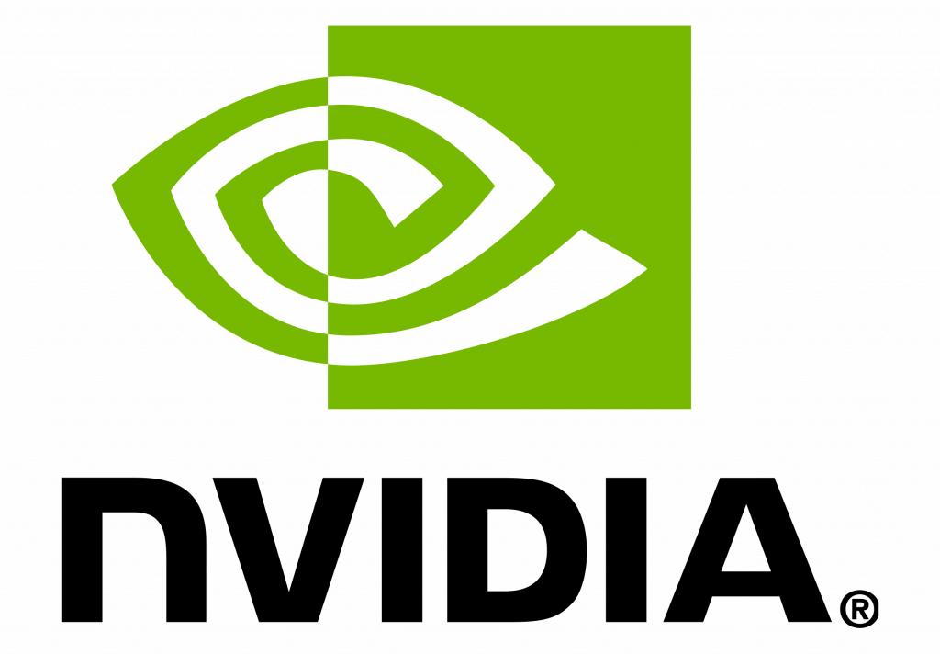
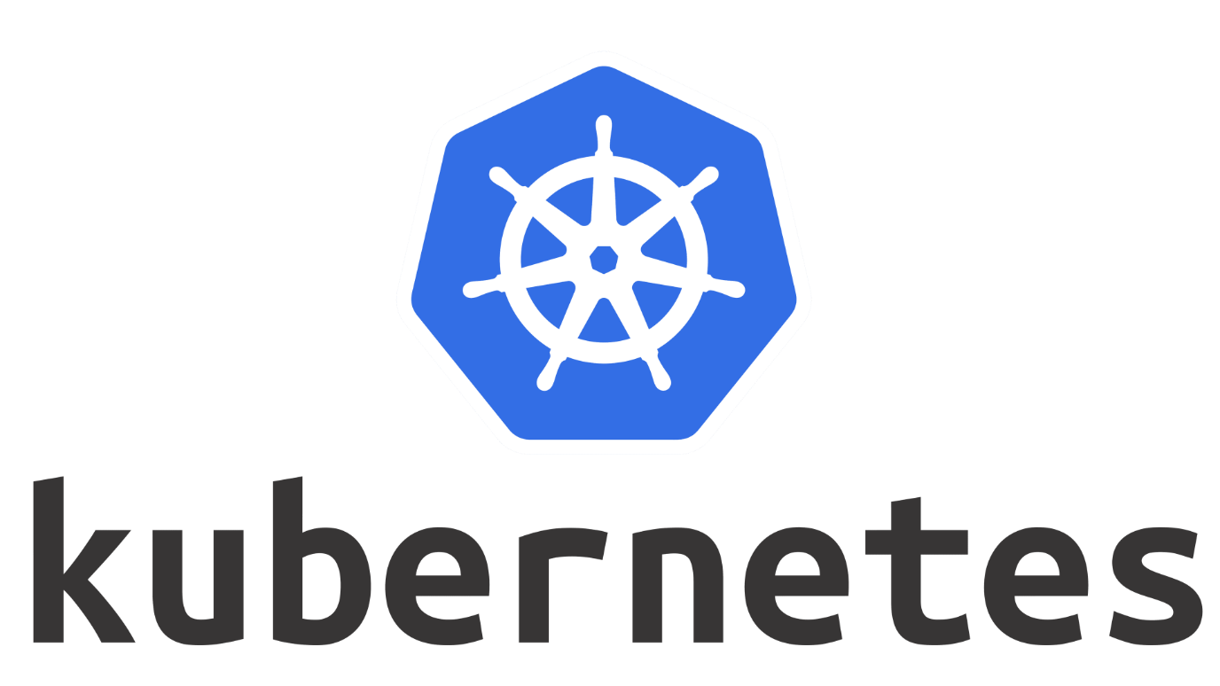
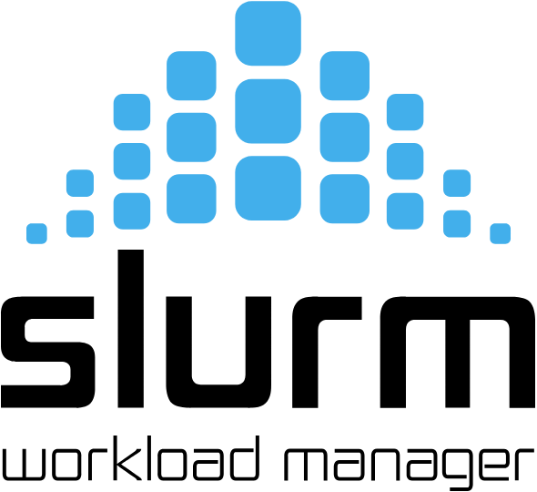





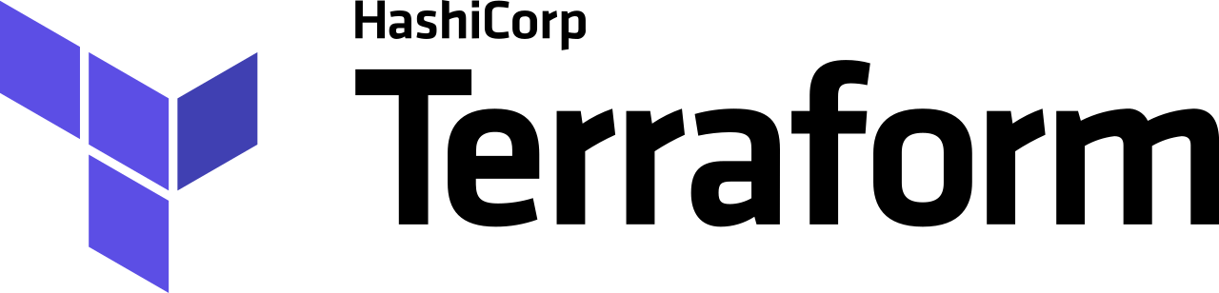




AI FACTORY ENGINE
Run Your AI Factory Like a Business,
Not Just GPU Infrastructure.
VEKTOR is the full-stack engine that orchestrates GPU and AI workloads, turns token into value, and helps operators deliver intelligence with peak utilization and lowest cost per token.
CHALLENGES WE SOLVE
BUILT FOR WHO LEADS AI INFRASTRUCTURE
Neoclouds & GPU-as-a-Service
Idle & Underutilized GPUs
Rising Infrastructure Costs
Fragmented Operations
Colocation & DC Operators
Valuable GPU capacity sits unused while demand fluctuates.
Increasing GPU investments with limited visibility into ROI.
Multiple tools, schedulers and spreadsheets create complexity and silos.
Enterprise AI Platforms
AI Model Hosting
Slow AI Workload Delivery
Difficult Multi-Tenant Management
No Clear Monetization Strategy
High Performance Compute
Training and inference jobs wait for available resources.
Delivering secure, isolated GPU environments across customers is challenging.
Hard to measure, price and monetize GPU consumption effectively.
Sovereign & Regulated AI
WHY VEKTOR?
AI Workload Orchestration
GPU Observability & AIOps
Token Farm / AI Compute Marketplace
Schedule training, inference and HPC workloads across pools, clusters and models.
Real-time visibility into utilization, performance, health and cost.
Meter token usage and monetize GPU capacity like never before.
GPU Farm Management
Revenue & Monetization
Maximize GPU utilization and reduce idle capacity.
Track usage, pricing and margins across your GPU estate.
LUMI, AI Coworker
Multi-Tenant GPU Cloud Platform
Ask, investigate and act. Automate operations with human-in-the-loop approval.
Deliver secure, self-service GPU clouds for multiple tenants at scale.
BUSINESS OUTCOMES THAT DRIVE IMPACT
Higher GPU Utilization
Lower Cost per Token
Faster AI Workload Delivery
Increased Revenue & Monetization
Secure Multi-Tenant AI Infrastructure
Sustainable AI Operations
More compute. More output.
Run efficient. Stay competitive.
Reduce wait times. Accelerate innovation.
Turn utilization into measurable revenue.
Isolated. Governed. Compliant.
Optimize for efficiency. Build a greener future.
—— 100+ INTEGRATIONS ——
Turn GPU Infrastructure into
an Intelligent AI Factory.
REQUEST A DEMO
vektor.unityone.ai
contact@unityone.ai

