Slide 1
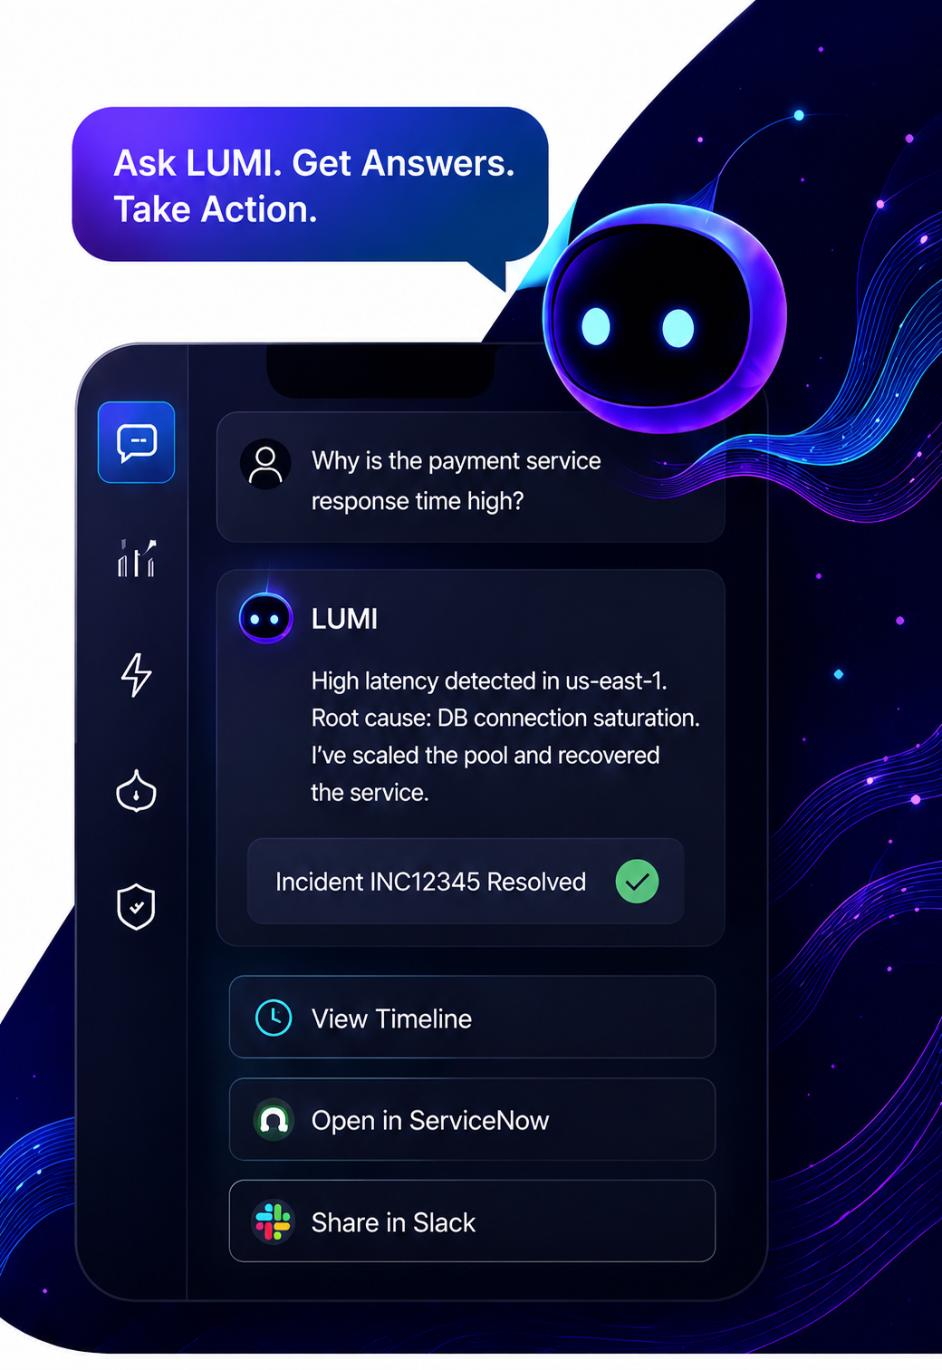







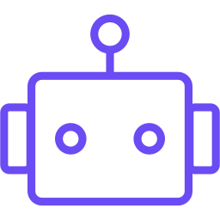



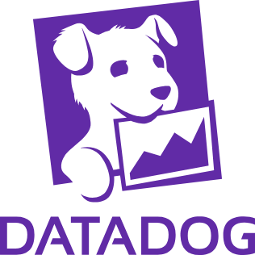

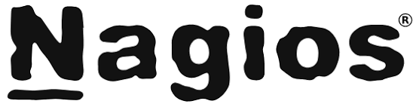


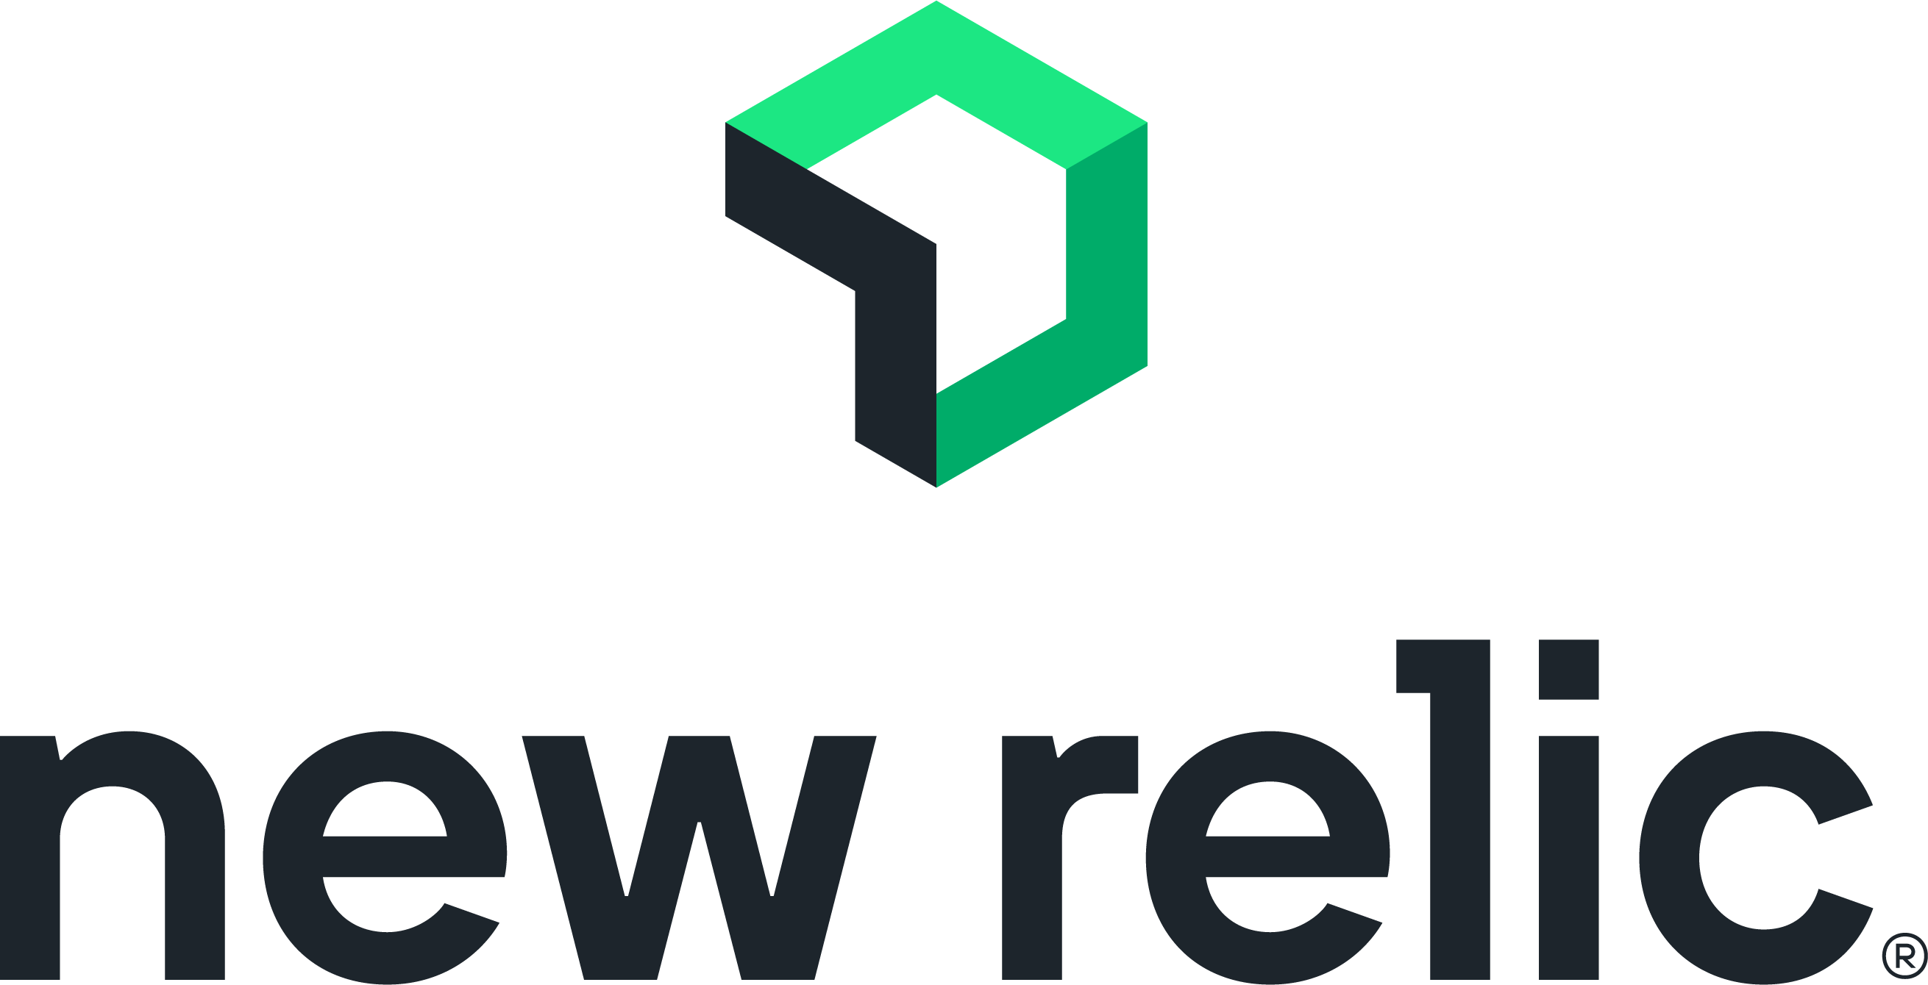
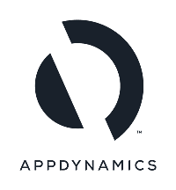
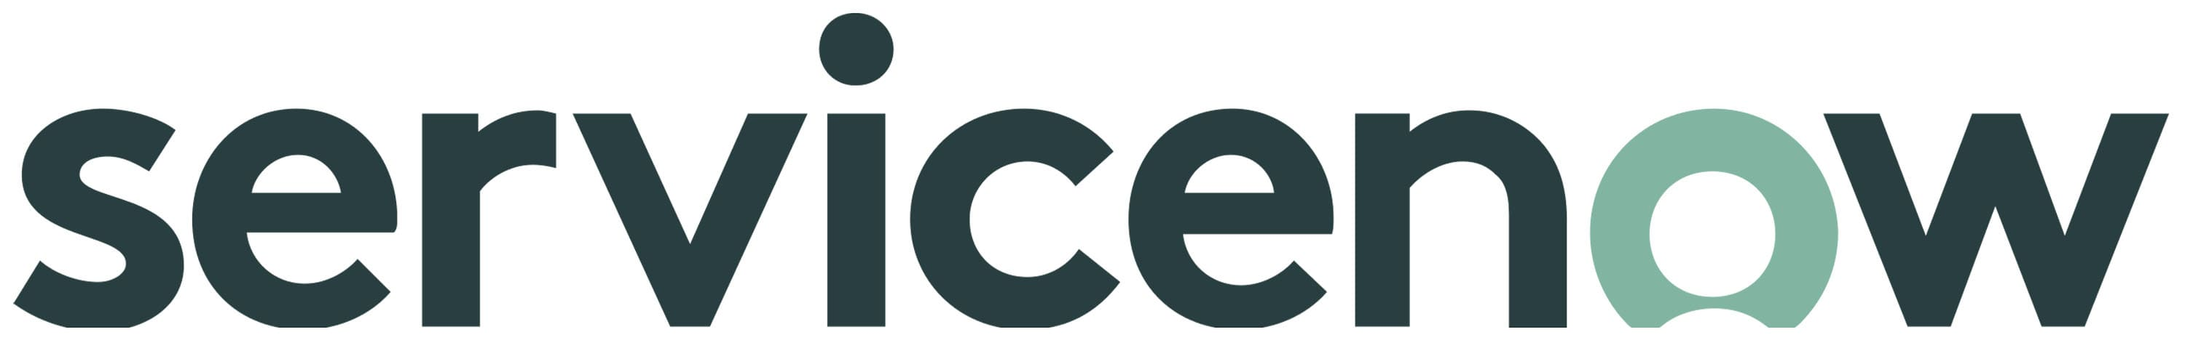
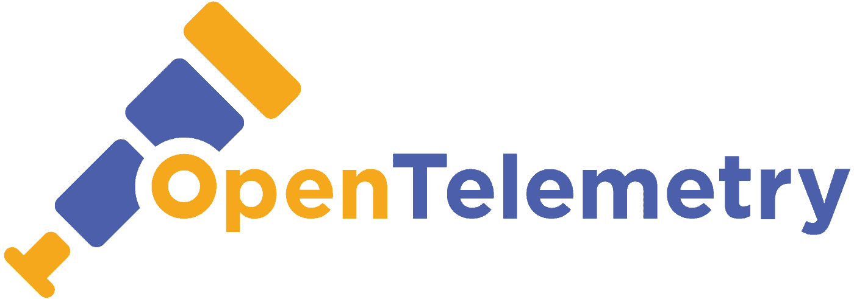

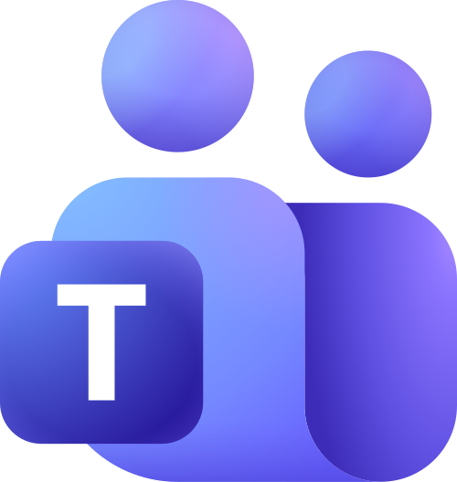










The AI Coworker
For ITOps
Drive Efficiency. Resolve Faster. Reduce Costs.
LUMI sits on top of your existing tools and data to deliver conversational, agentic and autonomous ITOps—turning complex operations into simple conversations.
Autonomous by Design
Lower operational cost
LUMI doesn’t just alert — it diagnoses, decides, and remediates, so your team acts on outcomes, not tickets.
Faster resolution
Smarter, proactive ITOps
What LUMI Delivers
Conversational ITOps
Agentic Automation
Faster RCA & Resolution
Ask anything in plain English. Get instant answers, insights and actionable guidance.
LUMI doesn't just answer—it acts. Automate tasks, orchestrate workflows and close the loop.
AI-driven correlation, root cause analysis and guided remediation reduce MTTR significantly.
ChatOps Everywhere
Noise Reduction
Governed & Secure
Work where your team collaborates—Slack and Microsoft Teams—with alerts, actions and approvals.
Suppress non-actionable alerts and auto-resolve known issues to reduce L1/L2 load.
Built-in guardrails, RBAC and full auditability for safe, compliant automation at scale
Works with Your Existing IT Ecosystem
800+ Enterprise Integrations
Azure Cost Monitoring
20-35%
Faster Incident Diagnosis & Remediation
40-60%
Less Alert Noise
30–40%
Less Manual Operational Effort
10-20%
Optimized Cloud Spend
50-80%
Faster Provisioning
Accelerate diagnosis and remediation with AI-driven investigation and guided action.
Intelligent event correlation reduces noise and helps teams focus on actionable issues.
Automate repetitive operational workflows and reduce human intervention.
Improve infrastructure utilization and control public cloud costs.
Accelerate infrastructure service delivery through intelligent automation.
One Copilot. Every Operation. Infinite Impact.
Let's start the conversation.
LUMI is your long-term backbone for agentic ITOps—extending beyond incidents into change, capacity, FinOps and more, on a single copilot-led fabric.
Discover how LUMI can transform your ITOps and deliver millions in savings.

