Slide 1
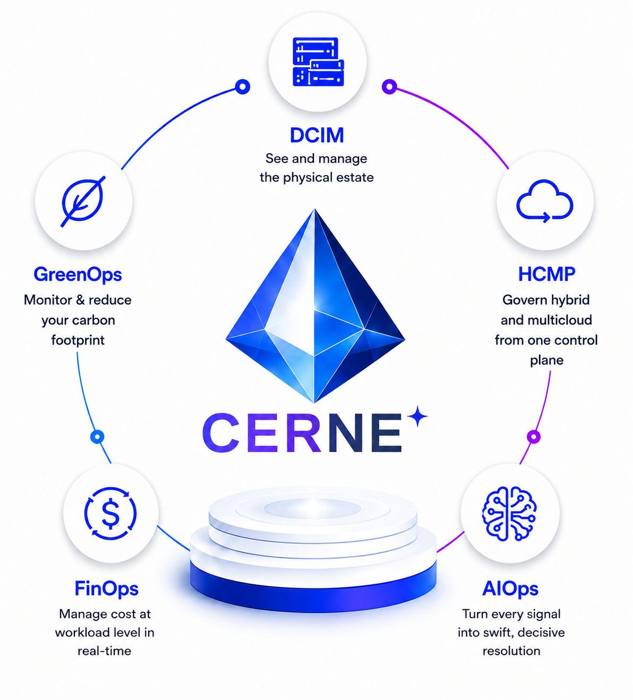
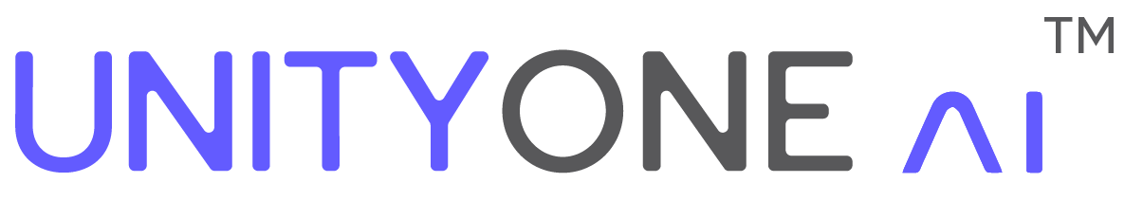
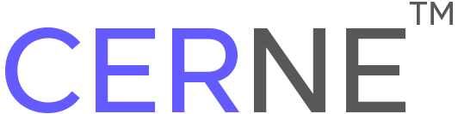



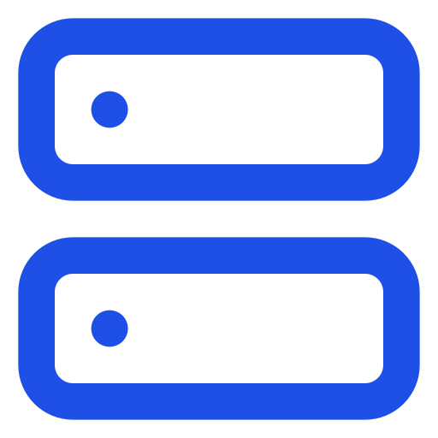
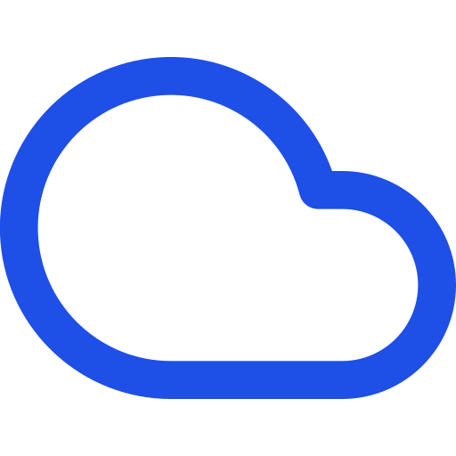
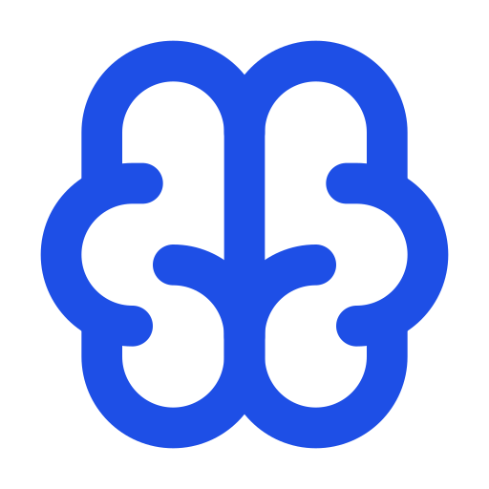









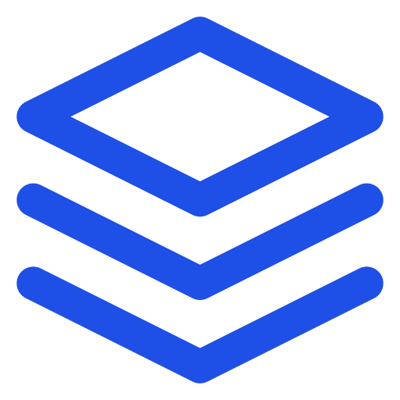


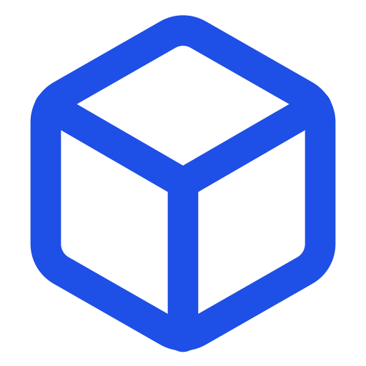
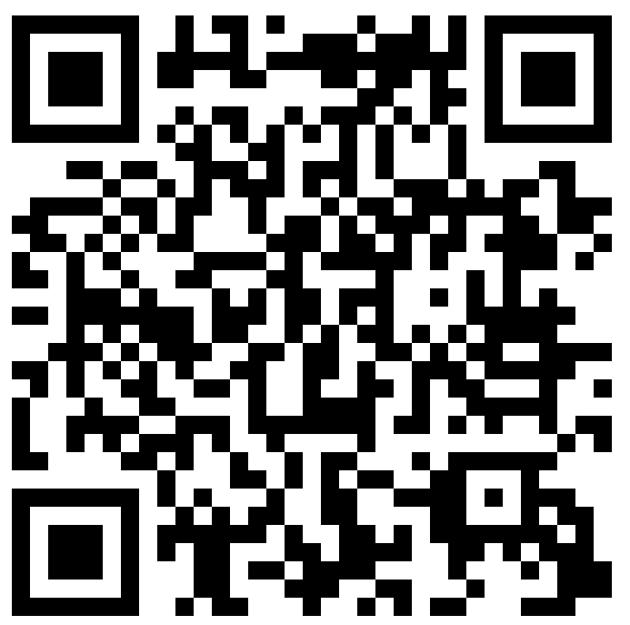


Your Entire
IT Operation.
One Intelligent Platform.
AGENTIC INTELLIGENCE PLATFORM
FOR CLOUD MANAGEMENT
Unify infrastructure, clouds, and operations with CERNE—an AI-powered platform that replaces 50+ tools, accelerates resolution, optimizes cost, and drives sustainable IT.
Unify Everything
AI That Works for You
Governed Autonomous ITOps
Manage physical infrastructure, hybrid & multicloud environments, and services from one intelligent control plane.
From insights to actions—AI Copilot delivers RCA, recommendations, and autonomous resolutions in real time.
Policy-driven, auditable, and human-approved automation with enterprise-grade guardrails.
EVERYTHING YOU NEED. ONE PLATFORM.
DCIM
HCMP
AIOps
FinOps
GreenOps
See and manage your entire physical infrastructure.
Govern hybrid and multicloud from one control plane.
Turn noise into clarity. Resolve incidents faster with AI.
Optimize cost at every layer with real-time visibility.
Drive sustainability and reduce your carbon footprint.
Capacity & Power
Asset & Network
Environment Monitoring
Planning & Visualization
Discovery & Inventory
Cloud & K8s Management
Self-Service Catalogs
Policy & Orchestration
Full-Stack Observability
AI Correlation & RCA
Anomaly Detection
Auto Remediation
Cost Analytics
Showback / Chargeback
Budgeting & Forecasting
Optimization Engine
Sustainability Metrics
Carbon Analysis
Power Optimization
EOL & Efficiency Tracking
POWERED BY AI. BUILT FOR ENTERPRISE.
GenAI
Copilot
Agentic
Workflows
Hybrid &
Multicloud
Full-Stack
Observability
Intelligent
Automation
Policy-Based
Governance
Private LLM
Support
Human-in-the-Loop
Controls
REAL IMPACT. MEASURABLE RESULTS.
50+
95%
~25%
One
ITOps Tools
Consolidated
Faster Incident
Resolution
Cloud Spend
Optimization
Unified AI
Operations Platform
Experience CERNE Live
contact@unityone.ai
See how AI and automation can
transform your IT operations.
www.unityone.ai
unityone.ai/playground ›
One Platform. Every Operation.
Autonomous. Governed. Intelligent.

